Slide 1



Amazon Student Prime Package
Kyandre’ Roberts, Darrian Belcher, Chanslor Green, Evan Smith

Slide 2

Background
Many college students have a hard time adjusting to their new lives. This includes the following:
Fear of finding career opportunities
Funding for college
New environment
New social life

Slide 3
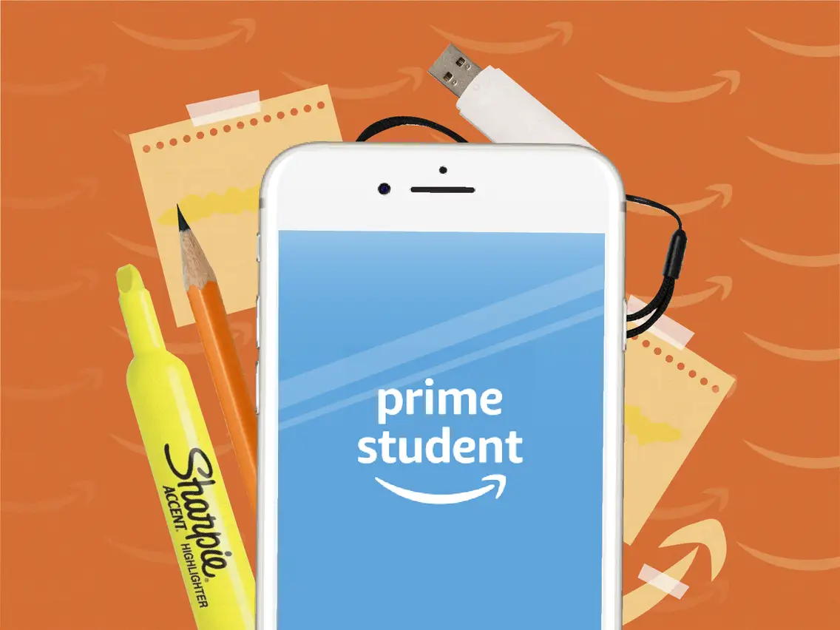
Introduction
Problem Statement: What’s the new service that you can provide to Prime Student Members to make their lives better?
Goal: We want to create a valuable addition to the Amazon Student Prime feature.

Slide 4


Our Solution
Product name: Amazon Student Prime Package
What’s included:
Amazon Success
Scholarships
Internship opportunities
Mentorship from Amazon + partner company employees
Resume Reviews
Amazon City
Nightlife
Local restaurants
Campus Events
Sports Events

Slide 5

Amazon Success
As college students, two time-consuming tasks that we all generally participate in are the tedious scholarship and internship search processes. Affordability is a crucial aspect of earning a college degree. In addition, the importance of professional development and internship opportunities to the evolution of career aspirations can’t be overstated. Amazon success offers students direct access to scholarships, internships, and mentorship from Amazon and partner companies’ employees.

Slide 6

Amazon City
We can all admit that the idea of attending college in a city that you know nothing about is scary. Some common questions that may plague your mind include: Where will I meet friends? What types of events will occur on and off-campus? With so many social events available in your city, you could potentially be overwhelmed. Amazon City acts as a hub of social, sports, and overall nightlife events within a 30 mile radius of the user’s zip-code, that will not only allow you to make friends and have amazing experiences, but also enable and promote the prioritization of mental health and self-care. Don’t burn yourself out with your academics and professional development events. Use Amazon city to ensure that you have a well-rounded college experience.

Slide 7

Valuable Benefits
Students have access to an all-in-1 bundle that is catered to the needs of young college students.
A platform that encourages professional development.
Helps students find a social life in a new environment.
Encourages a balanced lifestyle between academic/career success and social engagement.

Slide 8
Resources Used
GitHub ReadMe File
StackOverflow
Pexels: Copyright free stock images
W3 Schools
Amazon Prime
AWS
Visual Studio Code

Slide 9
Demo Video
https://drive.google.com/file/d/1lVVgLqAeyZ9nqZUrblVsgFVVylA0gHpx/view?usp=sharing

Slide 10

Thank you for your time Amazon!

